Slide 1

FOG DETECTION AND FREE SPACE SEGMENTATION FOR CAR NAVIGATION USING RESTORATION TECHNIQUE
PERSENTED BY BATCH-3
G. Maheswari (18NE1A0451)
CH. Saransai (18NE1A0432)
B. Sai Pujitha (18NE1A0420)
A . Venu Gopi (18NE1A0402)
GUIDED BY
Dr . K.KANTHI KUMAR M Tech, Ph.D.
Dr. Sk. EBRAHEEM KHALEELULLA M Tech, Ph.D.

Slide 2
CONTENTS
Abstract
Introduction
Modeling fog effects in images
Existing system
Proposed System
Applications
Tools and Technology used
Stimulation results
Conclusion
Future Scope
References

Slide 3
ABSTRACT
Implementing fog detection and free space segmentation for car navigation using restoration technique.
A restoration approach is applied on the images, and these images are grabbed in vehicle camera.
It finds out the density of fog, as well as position of the object where it is located.

Slide 4
INTRODUCTION
Free space detection is a fundamental task for autonomous or automated vehicles, since it provides the area where the vehicle can navigate safely. In structured environments, the free space area is mainly composed of the road surface.
Methods which restore the contrast of images grabbed onboard a moving vehicle under bad weather conditions are hardly encountered in the literature.

Slide 5
Modeling fog effects in Images
Koschmieder’s Law
The method proposed in this study is based on a physics law governing the attenuation of brightness contrast by the atmosphere. This law, derived by Koschmieder’s, is given as :
L = Lo e^βd +L∞(1−e^−βd)
It relates the apparent luminance L of an object located at distance d to the luminance Lo measured close to this object at a time when the atmosphere has an extinction co-efficient β. L∞ denotes the atmospheric luminance.

Slide 6
Duntley developed a contrast attenuation law:
It states that a nearby object exhibiting contrast “Co” with the background will be perceived at distance “d” with the following contrast:
1. C =( (Lo −L∞)/L∞)e^−βd
2. C= Coe^−βd

Slide 7
EXISTING SYSTEM
Existing system consists of some of the methods like
Method -1
a . Region of interest based on segmentation
b. Pitch Angle Sensitivity
Method-2
Segmentation of ROI based on Geodesic Maps
a. Optimal path Computation in Gray-level Images
b . Novel fog ROI Segmentation Approach

Slide 8
EXISTING SYSTEM
Method-3
Free space Detection Method
Restoration Principle
Flat world Restoration
Free space segmentation

Slide 9
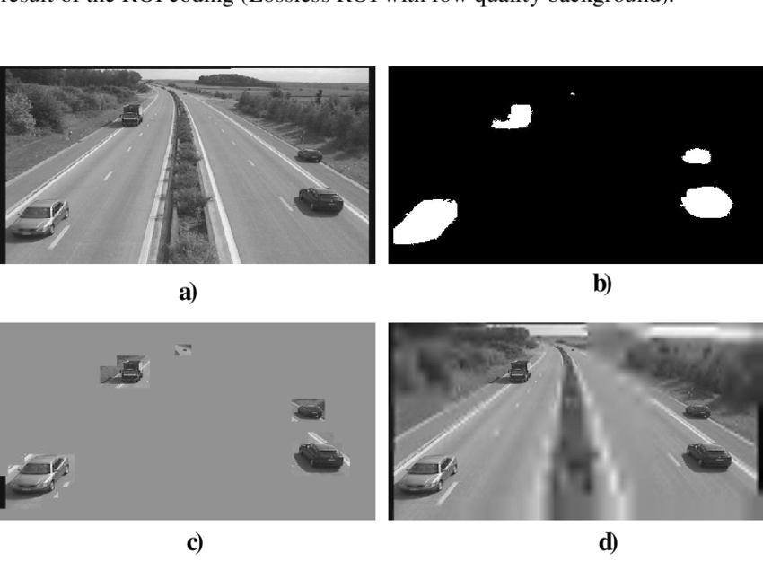
Region of interest based on segmentation
A region of interest is a selected subset of samples within a dataset identified for a particular purpose. For example, in medical imaging, the boundaries of a tumor may be defined on an image or in a volume, for the purpose of measuring its size..

Slide 10
Pitch Angle Sensitivity
It is the second measurement process is sensitive to variations of vehicle with respect to the road surface.
It is used to find out error “S” between the estimated meteorological visibility distance V(met) and actual meteorological visibility distance V(act)
S=V(met)– V(act)
Optimal path Computation in Gray-level Images
In this method which is used to display the minimal line to line gradient. It uses the Dijkstra’s algorithm allows the computing the shortest path.

Slide 11
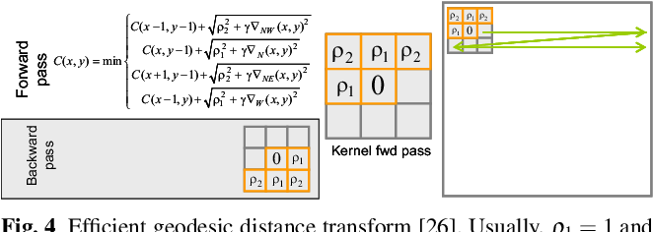
Weighted distance Transform On Curved Space(WDTOCS) . It aims to computing the shortest routes between sets on Gray-level images
R(a,b) = {x|DR(x) = minx DR(x)}

Slide 12
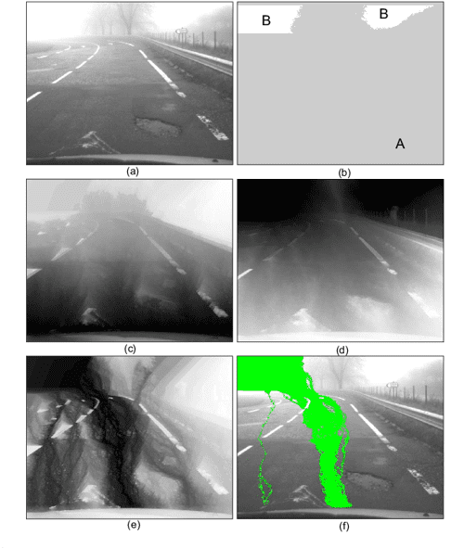
Novel Fog ROI Segmentation Approach
The optimal route computation approach detailed in previous section may be adapted to segment fog region of interest
Fig. 3 Fog ROI segmentation based on WDTOCS transform:
original image
origin (A) and destination (B) set points;
F∗A(x)distance map;
F∗B(x) distance map;
R(A,B) route map;
final segmented ROI overlaid in green.
In the distance maps, the distance is
mapped linearly into gray levels.
Figure-3

Slide 13
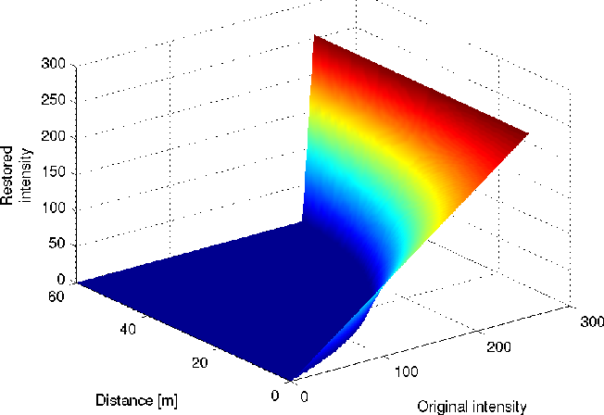
Free space detection method
Restoration Principle
Restoration is a process of reconstructing an image that has been degraded by using a prior knowledge of the degradation phenomenon..
R = max[0,I e^βd +A∞(1−e^βd)
Figure-4
3D plot of the corrected contrast
restoration function for β = 0.05 ,
A∞ = 255. The object intensity
may become null. Figure-4

Slide 14
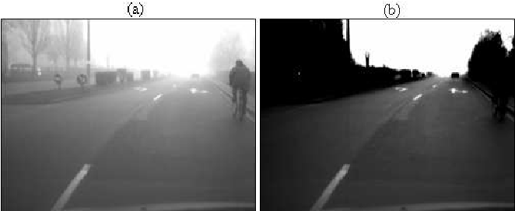
Flat world Restoration:
It is based on 3D model of the road scene is necessary to restore and contrast accurately.
Let us consider N*M denotes the size of image , c serves to set the Maximum distance. Indeed , no pixel has a contrast above 5% beyond V(met).
Sample result of flat world restoration. The intensity of vertical objects becomes null in the restored image: (a) original image; (b)result.

Slide 15
Free Space Segmentation:
Conversely, as soon as they are darker than the sky i.e. I <A∞, the contrast of vertical objects of the scene (other vehicles, trees) is falsely restored since their distance in the scene is largely overestimated. Consequently, according to, their intensity becomes null.
This is an inconvenient method, was plotted by understanding the value of the horizon line . However, this inconvenient can be turned into our advantage.
By detecting the pixels whose intensity is null after contrast restoration, we easily segment the vertical objects.
By using that we can segment the free space area accordingly by looking for the biggest connected component in front of the vehicle.

Slide 16
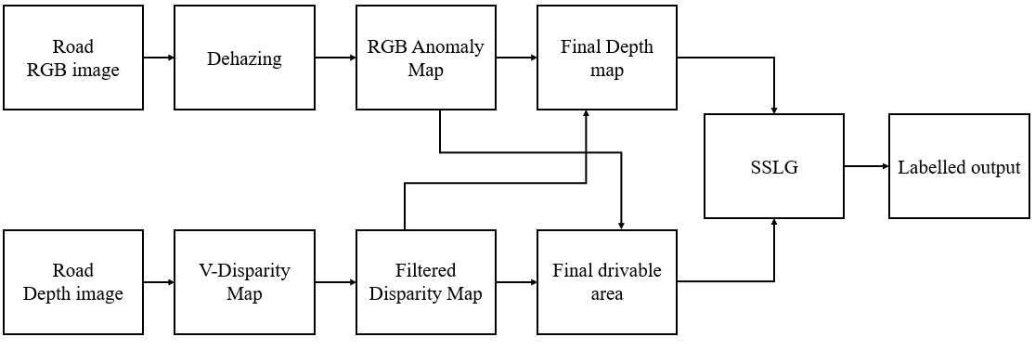
PROPOSED SYSTEM
In proposed system consists of some of blocks like:

Slide 17
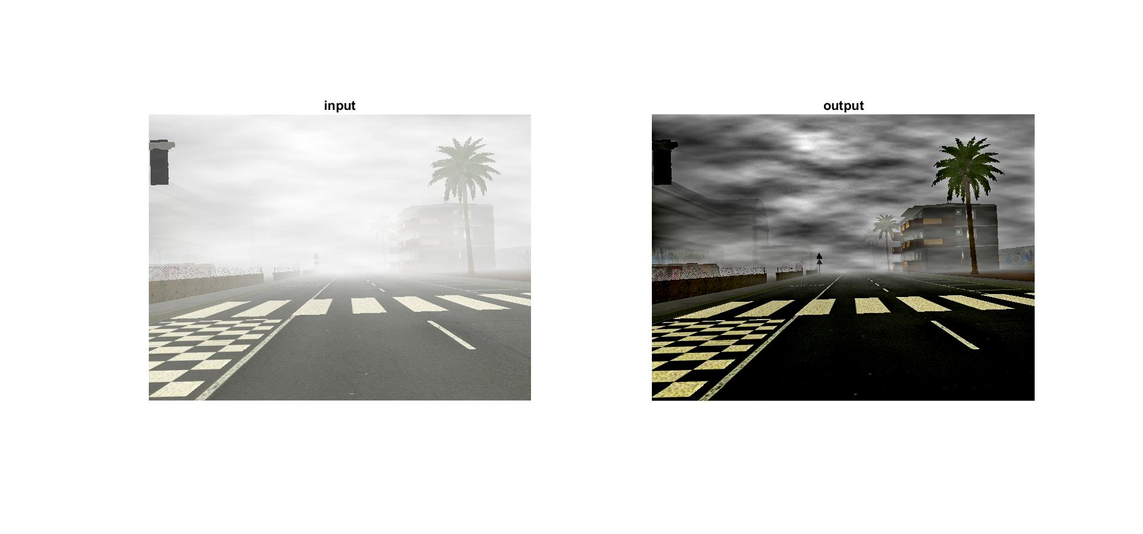
Dehazing Image
It was obtained by using bounding function
delta=zeta./(min_I).^0.5;
test_tr_proposed= 1./( 1 + ( MAX.*10.^(-0.05*delta) )./(A-min_I) );
Sample images
Input Image Output Image

Slide 18
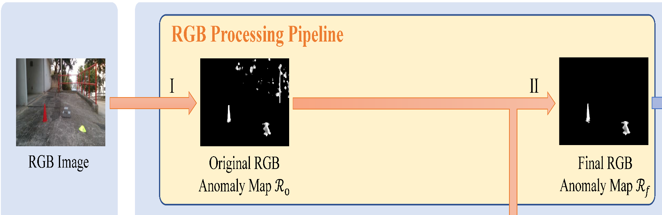
RGB Road Anomaly Map
Anomaly = 0.5 * depth Anomaly + 0.5 * rgb Anomaly;
It was done by using Segmentation:
The main advantage of using RGB-Road Anomaly Map to indefinity objects like vehicle, trees, traffic cones etc.….

Slide 19

Final-Depth Map
Edge detection is a technique of image processing used to identify points in a digital image with discontinuities, simply to say, sharp changes in the image brightness. These points where the image brightness varies sharply are called the edges (or boundaries) of the image.

Slide 20
V-Disparity Map
Gaussian smoothing filters are commonly used to reduce noise. Read an image into the workspace. Filter the image with isotropic Gaussian smoothing kernels of increasing standard deviations.

Slide 21
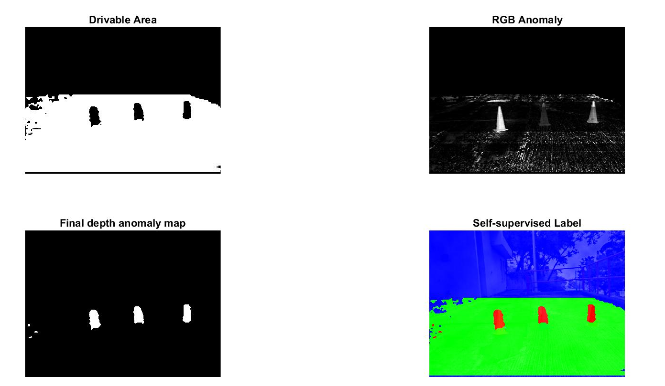
Final Drivable Area

Slide 22
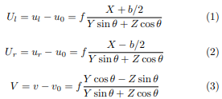
Self-Supervised Label Generator :(SSLG)
Our proposed Self-Supervised Label Generator (SSLG) is designed to generate self-supervised labels of drivable areas and road anomalies automatically.
The projection of the real world point P with coordinates of (X, Y, Z) on the image coordinates (U, V ) can be computed by (1)–(3):

Slide 23
Data set Collection
The distance measurement range for the Real sense RGB-D camera is up to 10m.Therefore, we remove the pixels with the distance larger than 10m and label them with the zero value. As for the hand-labeled ground truth, we label the unknown area with 0, the drivable area with 1 and road anomalies with 2.

Slide 24
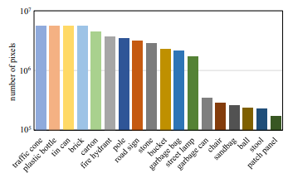
Data set Collection
Figure. : Number of finely annotated pixels (y-axis) and their associated categories (x-axis).

Slide 25
Intensity calculation
1.PSNR:
Peak signal-to-noise ratio (PSNR) is the ratio between the maximum possible power of an image and the power of corrupting noise that affects the quality of its representation. To estimate the PSNR of an image, it is necessary to compare that image to an ideal clean image with the maximum possible power.

Slide 26
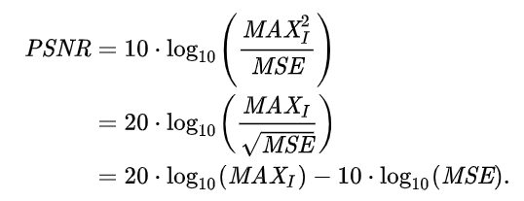

1.PSNR
peak signal-to-Noise Ratio
2. Mean square Error

Slide 27
Estimation of Mean Square Error
Where, O represents the matrix data of original image.
D represents the matrix data of degraded image. m represents the numbers of rows of pixels and i represents the index of that row of the image image. n represents the number of columns of pixels and j represents the index of that column of the image.
RMSE is the root mean square error.

Slide 28
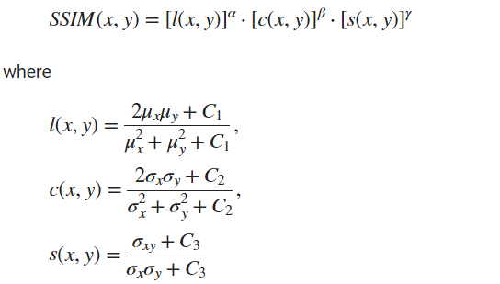
SSIM Calculation(Structural Similarity Index)
The SSIM Index quality assessment index is based on the computation of three terms, namely the luminance term, the contrast term and the structural term. The overall index is a multiplicative combination of the three terms.

Slide 29

The Terms Can be Explained as
where μ_{x}, μ _{y} , σ _{x} , σ _{y}, and σ _{xy} are the local means, standard deviations, and cross-covariance for images x, y. If α = β = γ = 1 (the default for Exponents), and C₃ = C₂/2 (default selection of C₃) the index simplifies to:

Slide 30
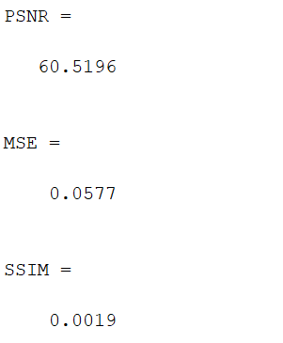
PSNR , MSR, SSIM Obtained Values

Slide 31
Applications
This project can be implemented in Coal Mines
This application can be implemented in Fire Accidents
This application can be used in robotic Wheelchairs.

Slide 32
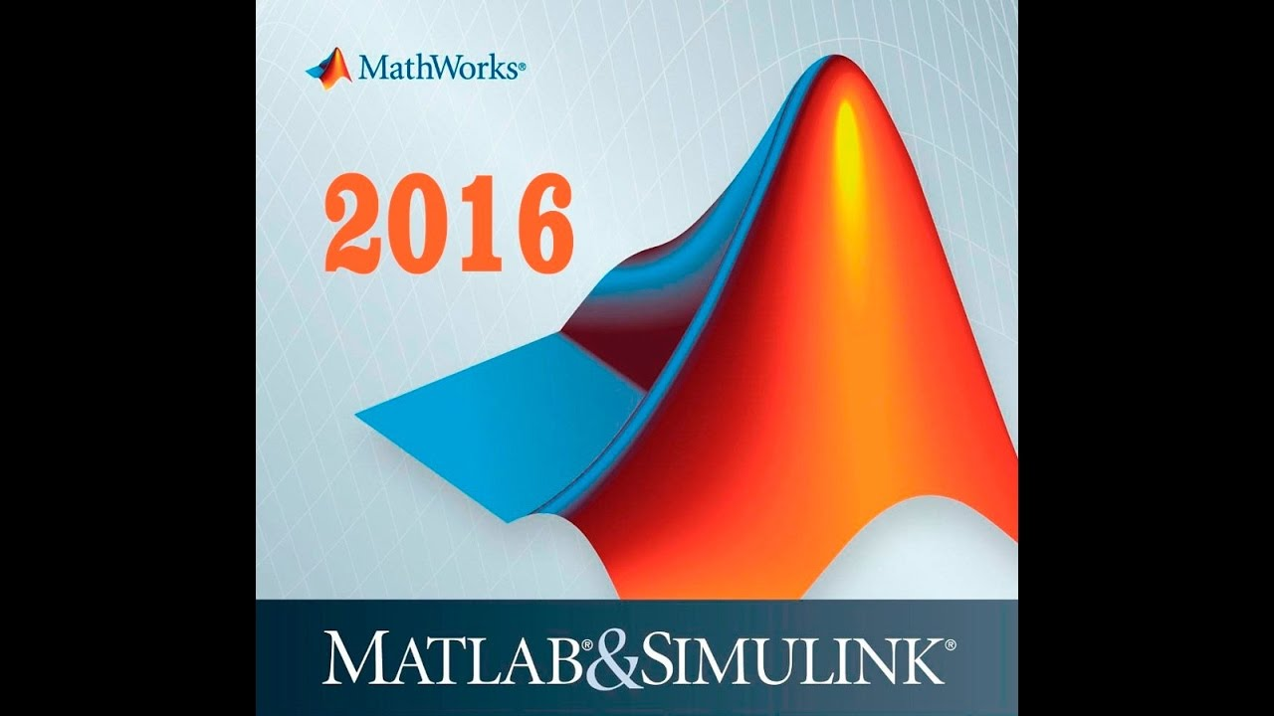
Tools and Technology used

Slide 33

Overall Output Image

Slide 34
Conclusion
The project “FOG DETECTION AND FREE SPACE SEGMENTATION FOR CAR NAVIGATION USING RESTORATION TECHNIQUE” is successfully implemented and Tested by using MATLAB 2016 .
Here the proposed system identify the objects clearly during morning time fog, It provides derivable Area, It display the intensity Values, Finally It provides the distance from object to the vehicle.

Slide 35
Future Scope
In this Project we, can plan to investigate our work with planning algorithms for robotic wheel chair achieve autonomous navigation.

Slide 36
REFERENCES
[1]. U.S. Department of Transportation. Traffic Safety Facts—Critical Reasons for Crashes Investigated in the National Motor Vehicle Crash Causation Survey; National Highway Traffic Safety Administration (NHTSA): Washington, DC, USA, 2015.
[2].The Car Connection. 12 October 2018. Available online: https://www.thecarconnection.com/news/1119327_u-s-to-allow-brighter-self-dimming-headlights-on-new-cars (accessed on 30 June 2020).

Slide 37
THANK YOU

